Slide 1
Server-side Development with NodeJS, Express and MongoDB Course Overview

Slide 2
Expected Background
Should have good working knowledge of:
JavaScript
Good knowledge of ES 5 is necessary
ES 2015+ preferred (at least arrow functions)
Must have completed the course Front-End web development with React
To understand the Front-end side of the story

Slide 3
Web Design and Development
Design
User Interface(UI)/User Experience (UX) Design
Visual Design
Prototyping
Colors, Graphics and Animation
Development, Building and Deployment
Web UI Frameworks: Bootstrap 4
JavaScript Frameworks/Libraries: Angular/React
Hybrid Mobile Frameworks: Ionic, Cordova, NativeScript and React Native
Server-side Development: Node + Express + MongoDB

Slide 4
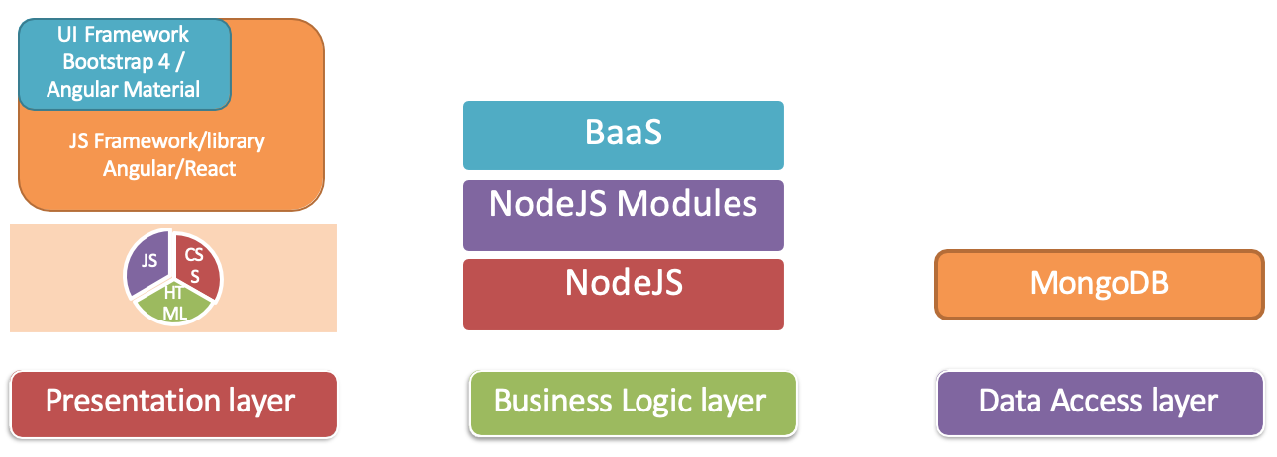
Full Stack Web Development

Slide 5
Course Outline
Node.js and Node modules
Express Framework
MongoDB
Backend as a Service (BaaS)

Slide 6
Module 1: Introduction to Server-side Development
Review - Setting up Development Environment: Git and Node
Introduction to Node.js and NPM
Node Modules
Node and HTTP
Introduction to Express
Assignment 1

Slide 7
Module 2: Data and data manipulation for NodeJS applications
Express Generator
Introduction to MongoDB
Node and MongoDB
Mongoose ODM
REST API with Express, MongoDB and Mongoose
Assignment 2

Slide 8
Module 3: Security
Basic Authentication
Cookies, Tea and err ... Express Sessions
User Authentication with Passport
Mongoose Population
Assignment 3

Slide 9
Module 4: Backend as a Service (BaaS)
HTTPS and Secure Communication
Uploading Files
Cross-Origin Resource Sharing
OAuth and User Authentication
Backend as a Service (BaaS)
Assignment4

